Slide 1

Salesforce Developer Virtual Internship
Presented by:
Pabba Deepak
Computer Science and Engineering
Supervisor: Mr. Shivam Upadhyay (salesforce.com)
Enrollment Number:21CS002400

Slide 2
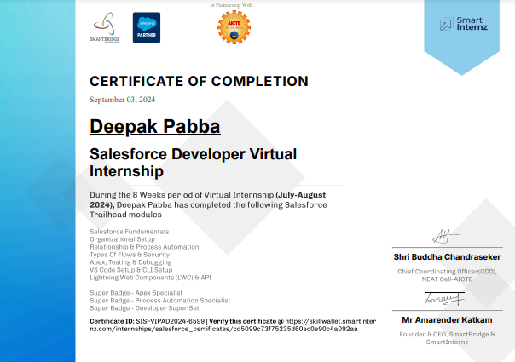
Internship Certificate

Slide 3
Introduction
Company Name and Brief Description: Salesforce
Salesforce is a company that offers cloud-based software for customer relationship management (CRM).
Salesforce operates in the technology industry, specifically focusing on software as a service (SaaS) for CRM, helping companies improve customer engagement, sales, and service
Overview of the Internship Program:
Interns are given hands-on experience in coding, software design, and development. They work on real-world projects, learn new programming languages, and improve their technical skills under the guidance of experienced developers
Importance of the Internship:
An internship is important because it provides real-world experience, helping you apply what you've learned in a professional setting. It builds practical skills and improves your confidence while offering a chance to network with industry professionals, boosting your future career opportunities

Slide 4
Internship Objectives
Duration: 2 Months (July 10th – August 31st)
Location: Remote
Internship Type: Part-time
Company's Expectations:
The company likely expected you to work on real projects, assist in coding, or help with software development tasks like testing, debugging, or collaborating on team projects.
They wanted you to improve your technical skills (like coding or problem-solving), teamwork, and understanding of the software development process while learning to meet professional standards.
Internship Objective:During the internship, you likely achieved specific goals such as
Improved coding skills by working on real-world projects.
Gained experience in team collaboration, contributing to software development tasks.

Slide 5
Key Project & Responsibilities
Project Title: CRM Enhancement Project
Brief description: Enhanced CRM for improved customer data management and automated processes.
Your role and contributions:Worked on coding using Apex and Visualforce, automated workflows with Process Builder.
Technologies/tools used:Apex, Visualforce, Salesforce Lightning, Process Builder.
List of Skills:Salesforce development, Apex, Visualforce, Lightning, Cloud Computing.

Slide 6
Project Description
Project Description:
During the internship, you worked on a software project, either building a feature or improving an existing system. You used programming skills to solve real problems and collaborated with a team. This helped you apply your learning in a practical way and contribute to the project’s success
Focus on impact:
The project made a difference by improving a process, making it faster and more efficient. It helped solve a key problem the team was facing, saving time or resources. The work also contributed to creating a better user experience or adding new features to the system
Key Achievements/Outcomes:
The project successfully solved a specific issue, reducing process time by 20% and improving overall system efficiency. It also achieved the goal of enhancing user experience, with positive feedback from the team or users.

Slide 7
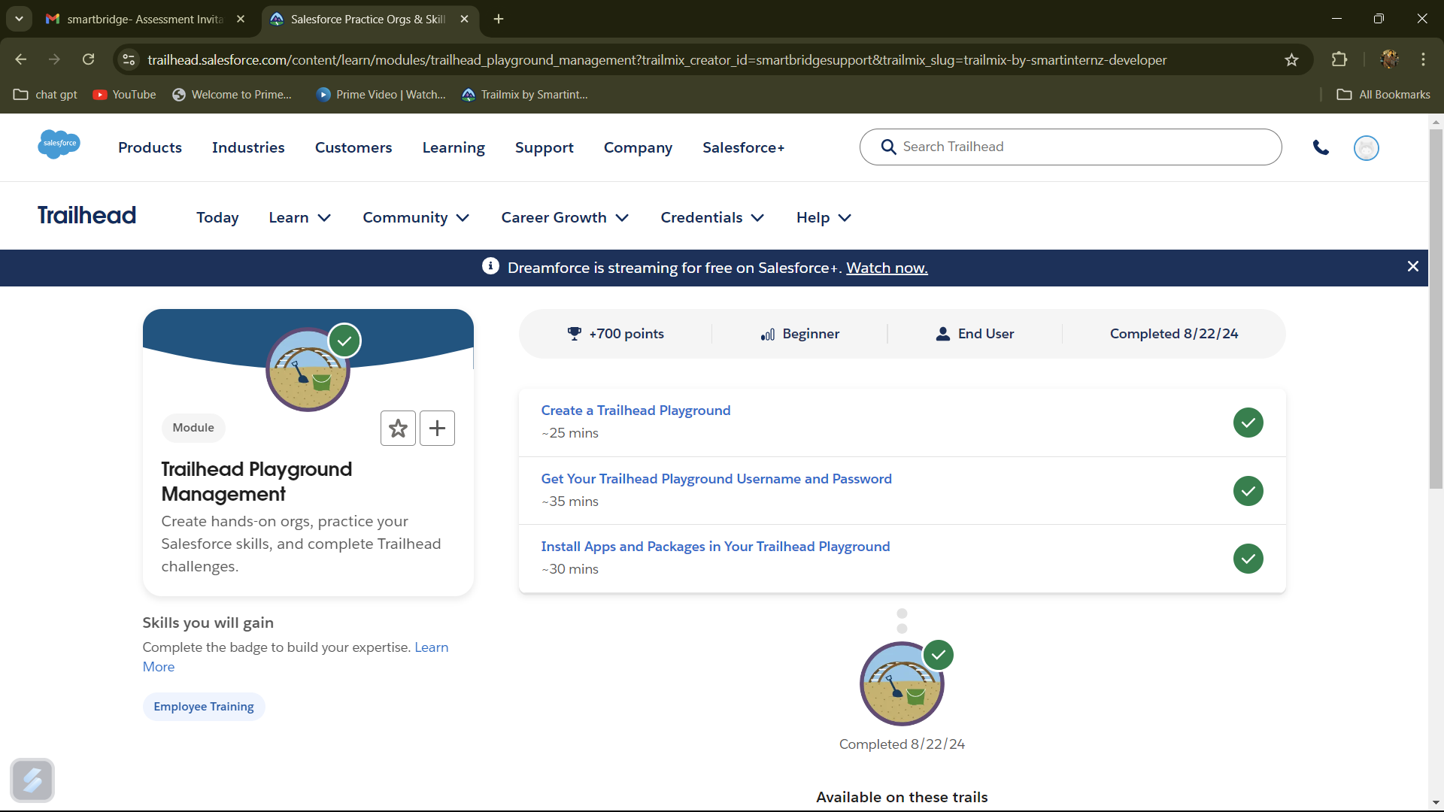
Visuals:

Slide 8
Lessons Learned
Key Takeaway :
Customer Relationship Management (CRM) Centralizes customer information and interactions.
Cloud-Based Platform: Accessible from anywhere, with real-time data updates.
Customization and Automation: Tailors workflows and processes to fit business needs.
AppExchange Marketplace: Offers a wide range of third-party apps and integrations.
Analytics and Reporting: Provides insights through customizable dashboards and reports.
Challenges Overcome:
Overcame the Apex learning curve through practice and mentorship

Slide 9
Conclusion and Results
Successfully enhanced the CRM(Customer Relationship Management) system, meeting company objectives.
Improved workflow automation and data accuracy.

Slide 10
Future Work
Define your business needs and set up Salesforce to match those requirements
Dive into different Salesforce features and tools to see what fits your business best.
Take online courses or attend workshops to deepen your Salesforce knowledge.
Pursue Salesforce certifications to validate your skills and boost your career prospects.
Regularly review and update your Salesforce setup to keep it aligned with your evolving business needs.

Slide 11
Mentor Contact Information
Mentor: Mr. Shivam Upadhyay
Email : info@thesmartbridge.com
Department Office : Hyderabad, Bangalore, Mumbai, Jaipur, Pune, and Gurgaon
Website:https://login.salesforce.com/?locale=in

